Slide 1
Spanning Tree Protocol

Slide 2
Objectives
Redundant topologies
Spanning Tree Protocol

Slide 3
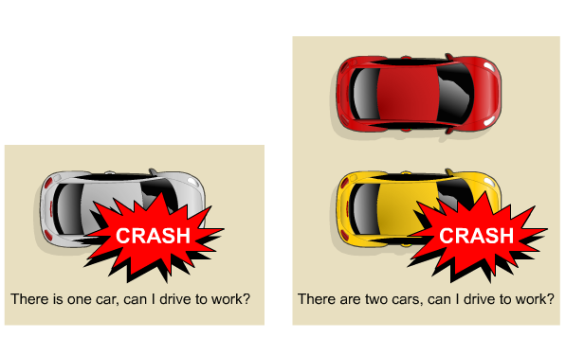
Redundancy
Redundant networking topologies are designed to ensure that networks continue to function in the presence of single points of failure.

Slide 4
Redundant Topologies
A goal of redundant topologies is to eliminate network outages caused by a single point of failure.
All networks need redundancy for enhanced reliability.

Slide 5
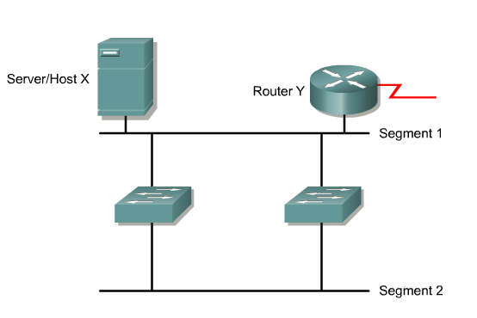
Simple Redundant Switched Topology

Slide 6
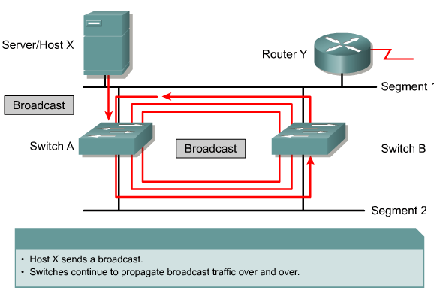
Broadcast Storm

Slide 7
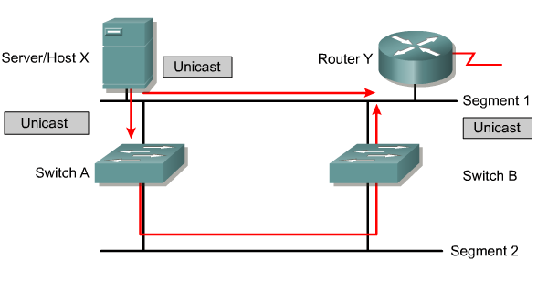
Multiple Frame Transmissions

Slide 8
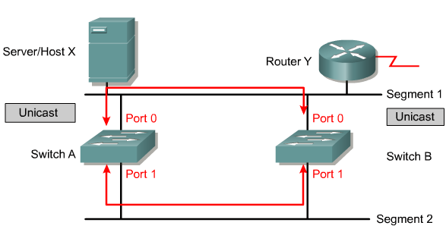
Media Access Control Database Instability
In a redundant switched network, it is possible for switches to learn the wrong information. A switch can learn that a MAC address is on a port when it is not.

Slide 9
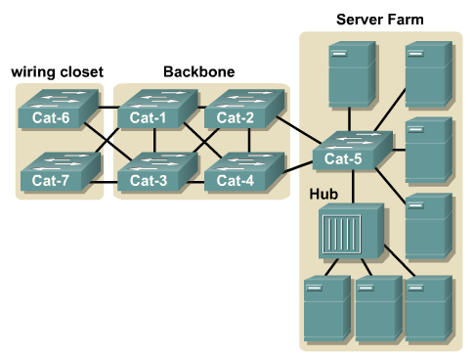
Using Bridging Loops for Redundancy

Slide 10
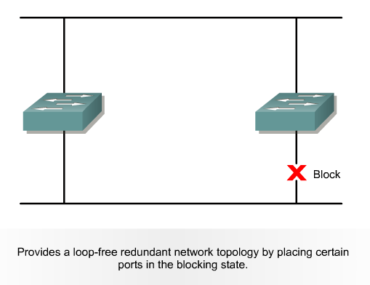
Spanning-Tree Protocol

Slide 11
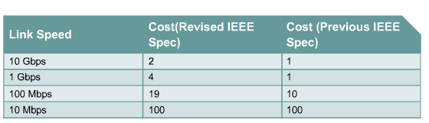
Spanning Tree Link Costs

Slide 12
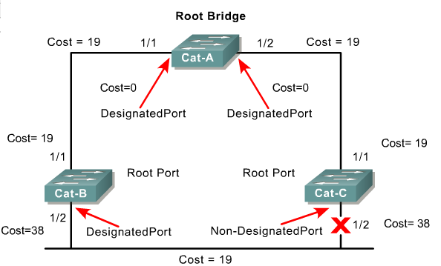
A Spanning Tree

Slide 13
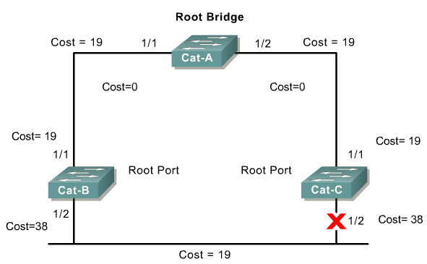
Spanning-Tree Operation
One root bridge per network.
One root port per nonroot bridge.
One designated port per segment.
Nondesignated ports are unused.

Slide 14
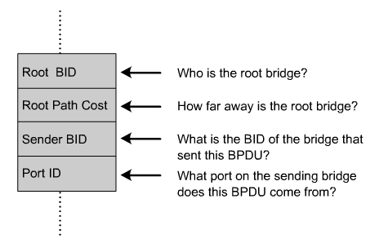
Bridge Protocol Data Unit
Bridge protocol data unit (BPDU)

Slide 15
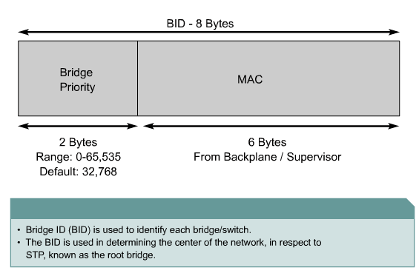
Bridge IDs

Slide 16
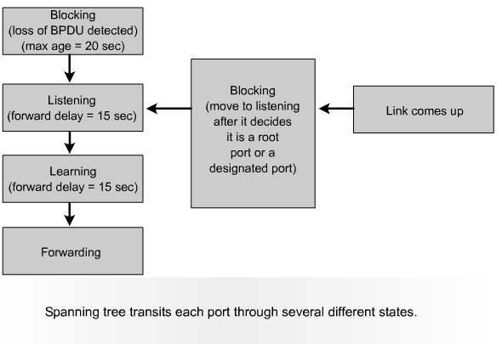
Spanning-Tree Port States

Slide 17
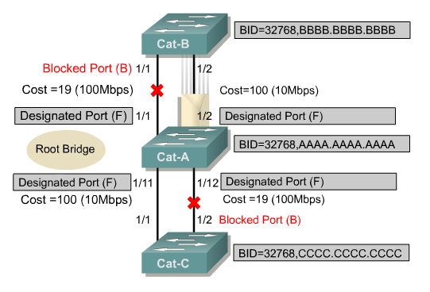
Spanning-Tree Recalculation
A switched internetwork has converged when all the switch and bridge ports are in either the forwarding or blocked state.

Slide 18
Rapid Spanning-Tree Protocol
The standard and protocol introduce the following:
  Clarification of port states and roles
  Definition of a set of link types that can go to forwarding state rapidly
  Allowing switches, in a converged network, to generate their own BPDUs rather than relaying root bridge BPDUs

Slide 19
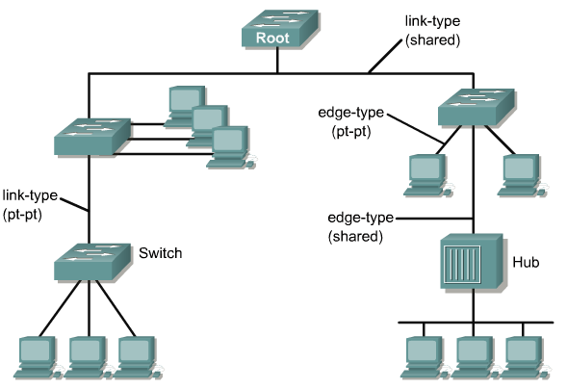
Rapid Spanning-Tree Port Designations
The Rapid Spanning Tree Protocol, IEEE 802.1w, will eventually replace the Spanning Tree Protocol, IEEE 802.1D.

Slide 20
Virtual LANs

Slide 21
Objectives
VLAN concepts
VLAN configuration
Troubleshooting VLANs

Slide 22
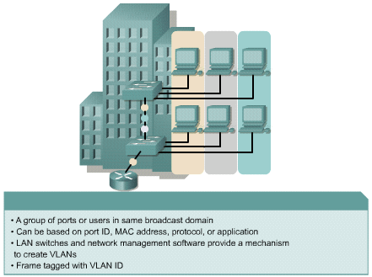
Introduction to VLANs

Slide 23
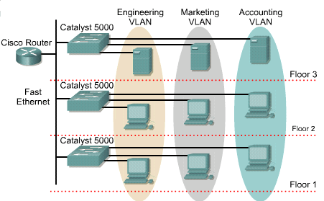
VLANs
VLANs logically segment switched networks based on an organization's functions, project teams, or applications as opposed to a physical or geographical basis.

Slide 24
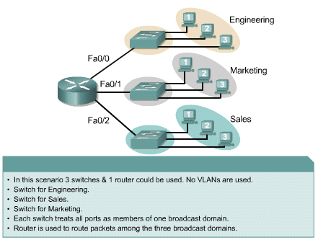
Broadcast Domains

Slide 25
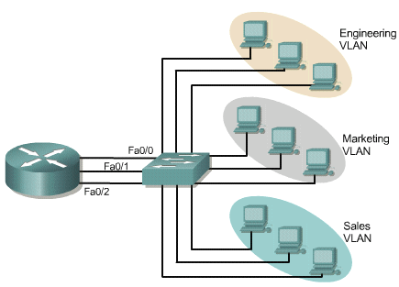
Example with 3 Broadcast Domains, 3 VLANs

Slide 26
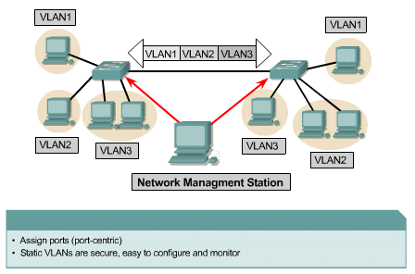
Static VLANs

Slide 27
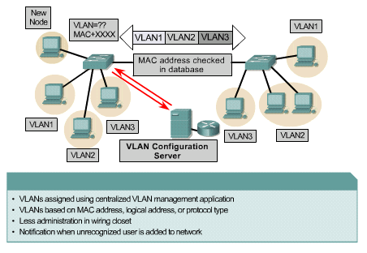
Dynamic VLANs

Slide 28
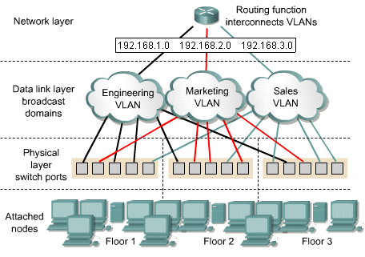
Port-Centric VLANs

Slide 29
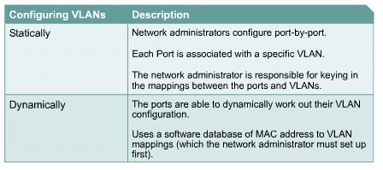
VLAN Configuration

Slide 30
Benefits of VLANs
Easily move workstations on the LAN
Easily add workstations to the LAN
Easily change the LAN configuration
Easily control network traffic
Improve security

Slide 31
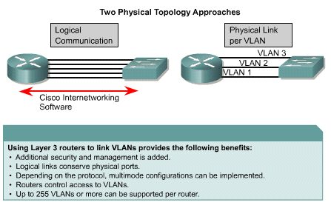
Communicating Between VLANs

Slide 32
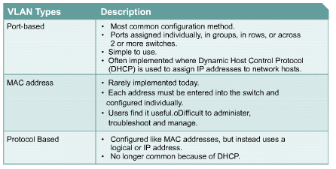
VLAN Types

Slide 33
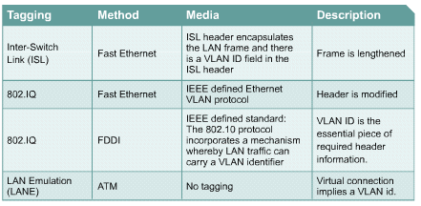
Inter-Switch Link

Slide 34
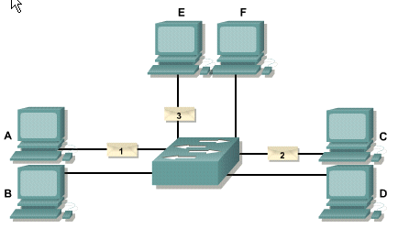
Concurrent Transmissions in a Switch

Slide 35
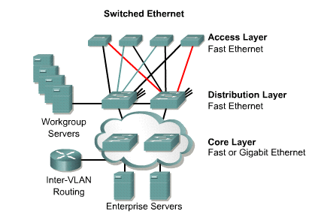
End-to-End VLANs

Slide 36
Static VLANs
Static VLANs work well in networks where the following is true:
  Moves are controlled and managed.
  There is robust VLAN management software to configure the ports.
  It is not desirable to assume the additional overhead required when maintaining end-station MAC addresses and custom filtering tables.

Slide 37
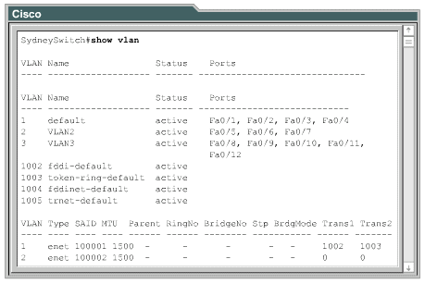
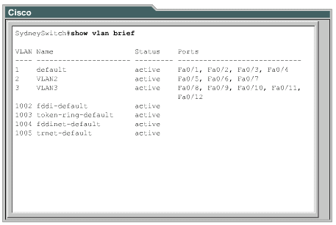
Verifying VLAN Configuration

Slide 38
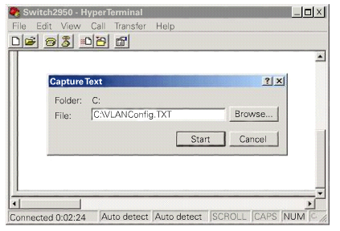
Saving VLAN Configuration
Back up using the copy running-config tftp command, or you can use the HyperTerminal Capture Text feature to store the configuration settings.

Slide 39
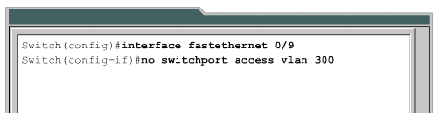
Deleting VLANs

Slide 40
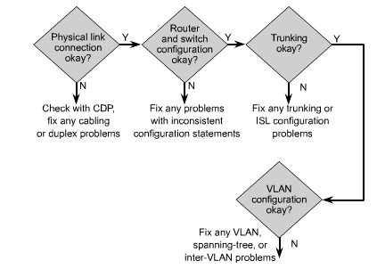
VLAN Problem Isolation

Slide 41
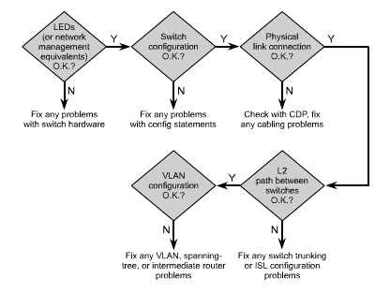
Problem Isolation in Catalyst Networks

Slide 42
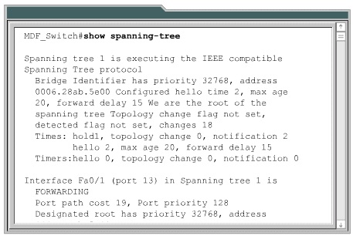
Preventing Broadcast Storms

Slide 43
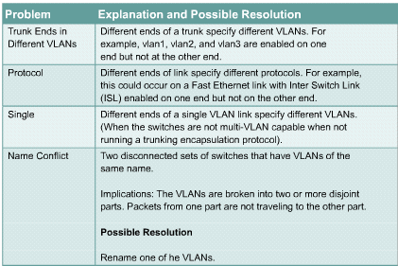
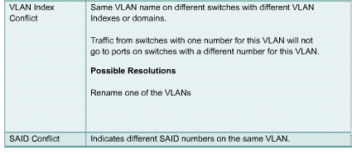
Common Problems in Troubleshooting VLANs

Slide 44
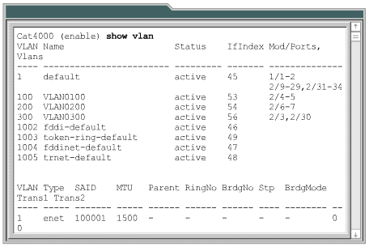
Catalyst IOS show vlan Command

Slide 45
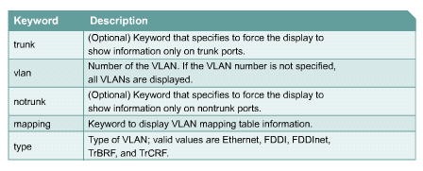
Catalyst IOS Keyword Syntax Description

Slide 46
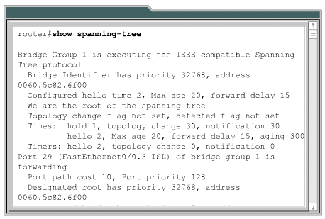
Catalyst IOS show spanning-tree Command

Slide 47
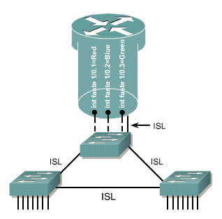
VLAN Troubleshooting Scenarios
A trunk link cannot be established between a switch and a router

Slide 48
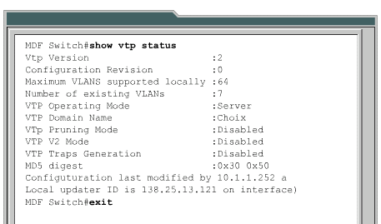
VLAN Troubleshooting Scenarios
VTP is not properly propagating VLAN configuration changes.

Slide 49
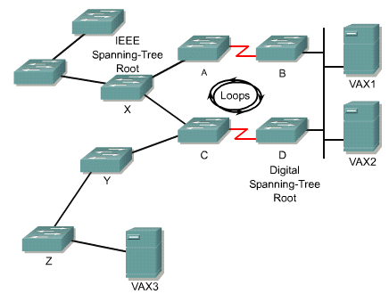
VLAN Troubleshooting Scenarios
Dropped packets and loops

Slide 50
Virtual Trunking Protocol

Slide 51
Objectives
Trunking
VTP
Inter-VLAN routing

Slide 52
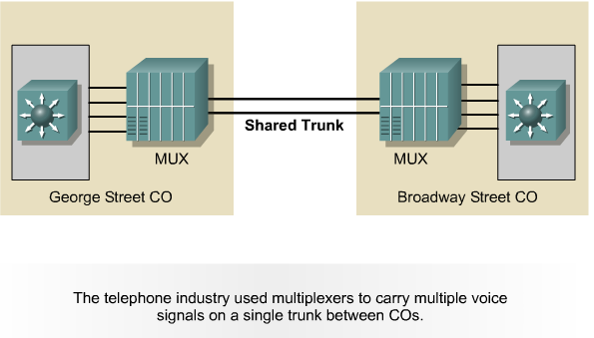
History of Trunking

Slide 53

Trunking Concepts

Slide 54
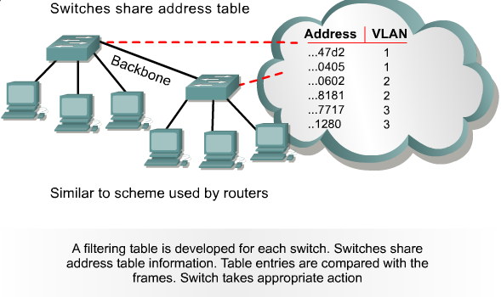
Frame Filtering

Slide 55
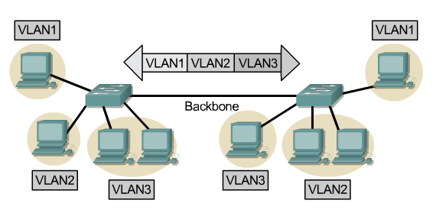
Frame Tagging

Slide 56
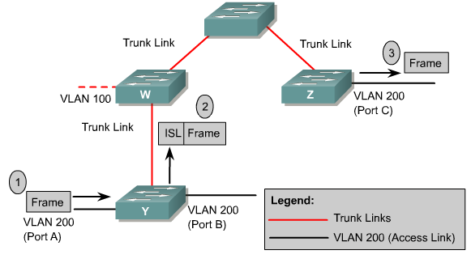
Inter-Switch Link Protocol

Slide 57
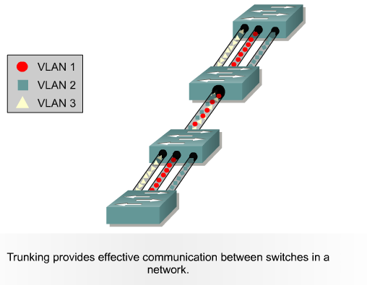
VLANs and Trunking

Slide 58
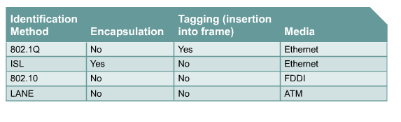
Frame Tagging and Encapsulation Methods

Slide 59
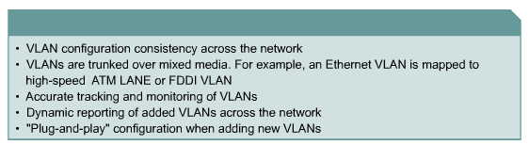
VTP Benefits

Slide 60

VTP Concepts
The role of VTP is to maintain VLAN configuration consistency across a common network administration domain.

Slide 61

VTP Mode Comparison

Slide 62

VTP Operation

Slide 63
VTP Implementation
There are two types of VTP advertisements:
  Requests from clients that want information at bootup
  Responses from servers
There are three types of VTP messages:
  Advertisement requests
  Summary advertisements
  Subset advertisements

Slide 64
VTP Basic Configuration Steps
Determine the version number
Choose the domain
Choose the VTP mode
Password protect the domain

Slide 65

Inter-VLAN Routing

Slide 66
Inter-VLAN Issues and Solutions
Two of the most common issues that arise in a multiple-VLAN environment are as follows:
  The need for end-user devices to reach nonlocal hosts
  The need for hosts on different VLANs to communicate

Slide 67

Router on a Stick

Slide 68


Physical and Logical Interfaces

Slide 69

Dividing Physical Interfaces into Subinterfaces

Slide 70

Configuring Inter-VLAN Routing

